Slide 1


Predictions of stock market based on headlines
Chenxuerui Li
Ziwei Jiang
Jianyao Fu
Senhao Hu

Slide 2
Table of Content
Questions, Analysis, Results & more
Dataset Description & Motivations…..………..Section 1
Data Exploration……………………..………....Section 2
Sentiment Analysis………………...………..….Section 3
Stock-News Modeling..………………...……....Section 4

Slide 3
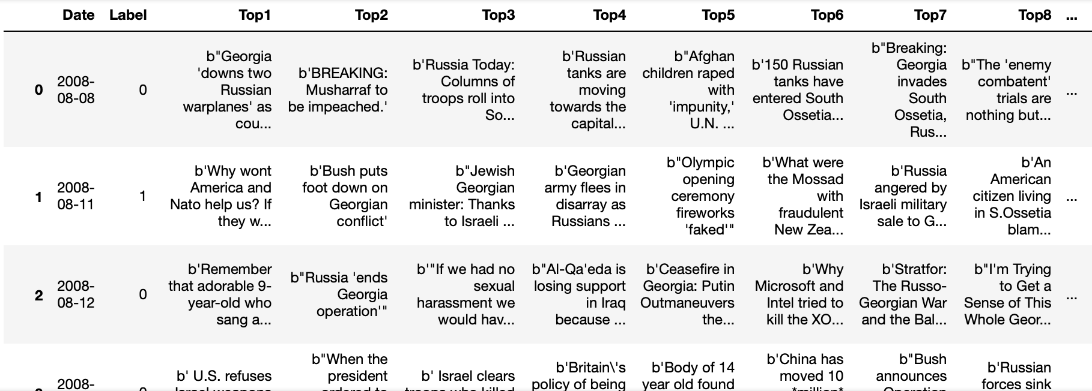
Dataset Description
Why this dataset is interesting
Our Belief
When betting the market flow and trend, the traders always utilize daily market news as a main signal.
Our dataset
This dataset is composed of top 25 daily news headlines based on reddit users’ vote followed by Dow Jones Industrial Average (DJIA).
Label Annotations
“1” when DJIA rose or stayed as the same.
“0” when DJIA decreased
Notes:
Comment: d
The training dataset is data before 2015/1/1, meanwhile, the test dataset is ones after 2015/1/1. This is a roughly 80%/20% split.

Slide 4

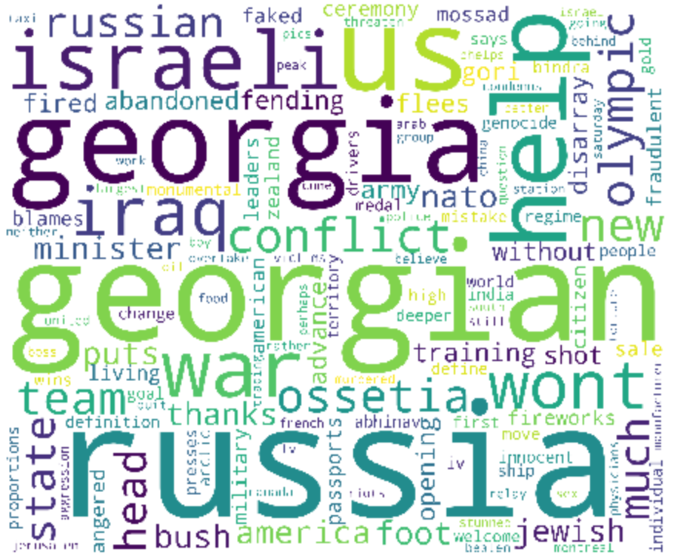
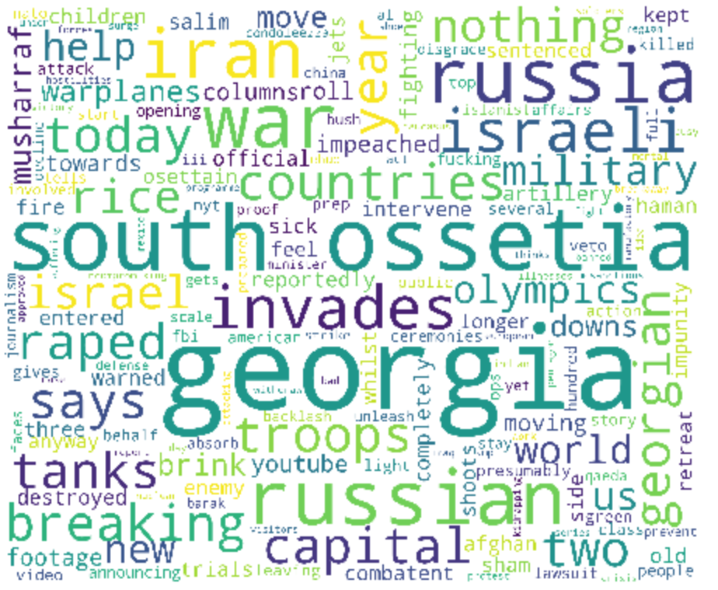
Data Exploration
Most Frequent Words in all headlines
When Stock Label = One
When Stock Label = Zero

Slide 5
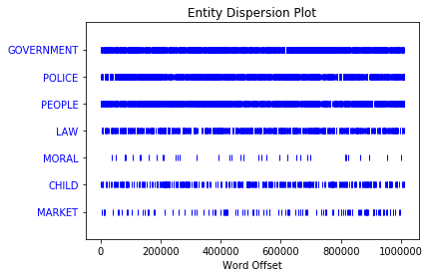
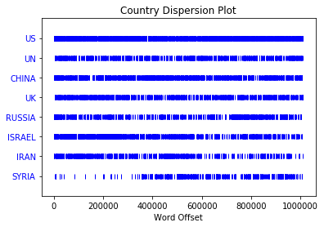
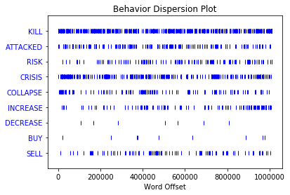
Data Exploration
Entity Dispersion plot
Country Dispersion plot
Behavior Dispersion plot
Get frequent mentioned entity & countries during different periods from text
Get relationship between behaviors
Takeaways:
“Buy” is far more less than “Sell”, because negative news have bigger effect
Market is always lagged behind the negative news

Slide 6

Data Exploration
Crisis-Related Words

Slide 7
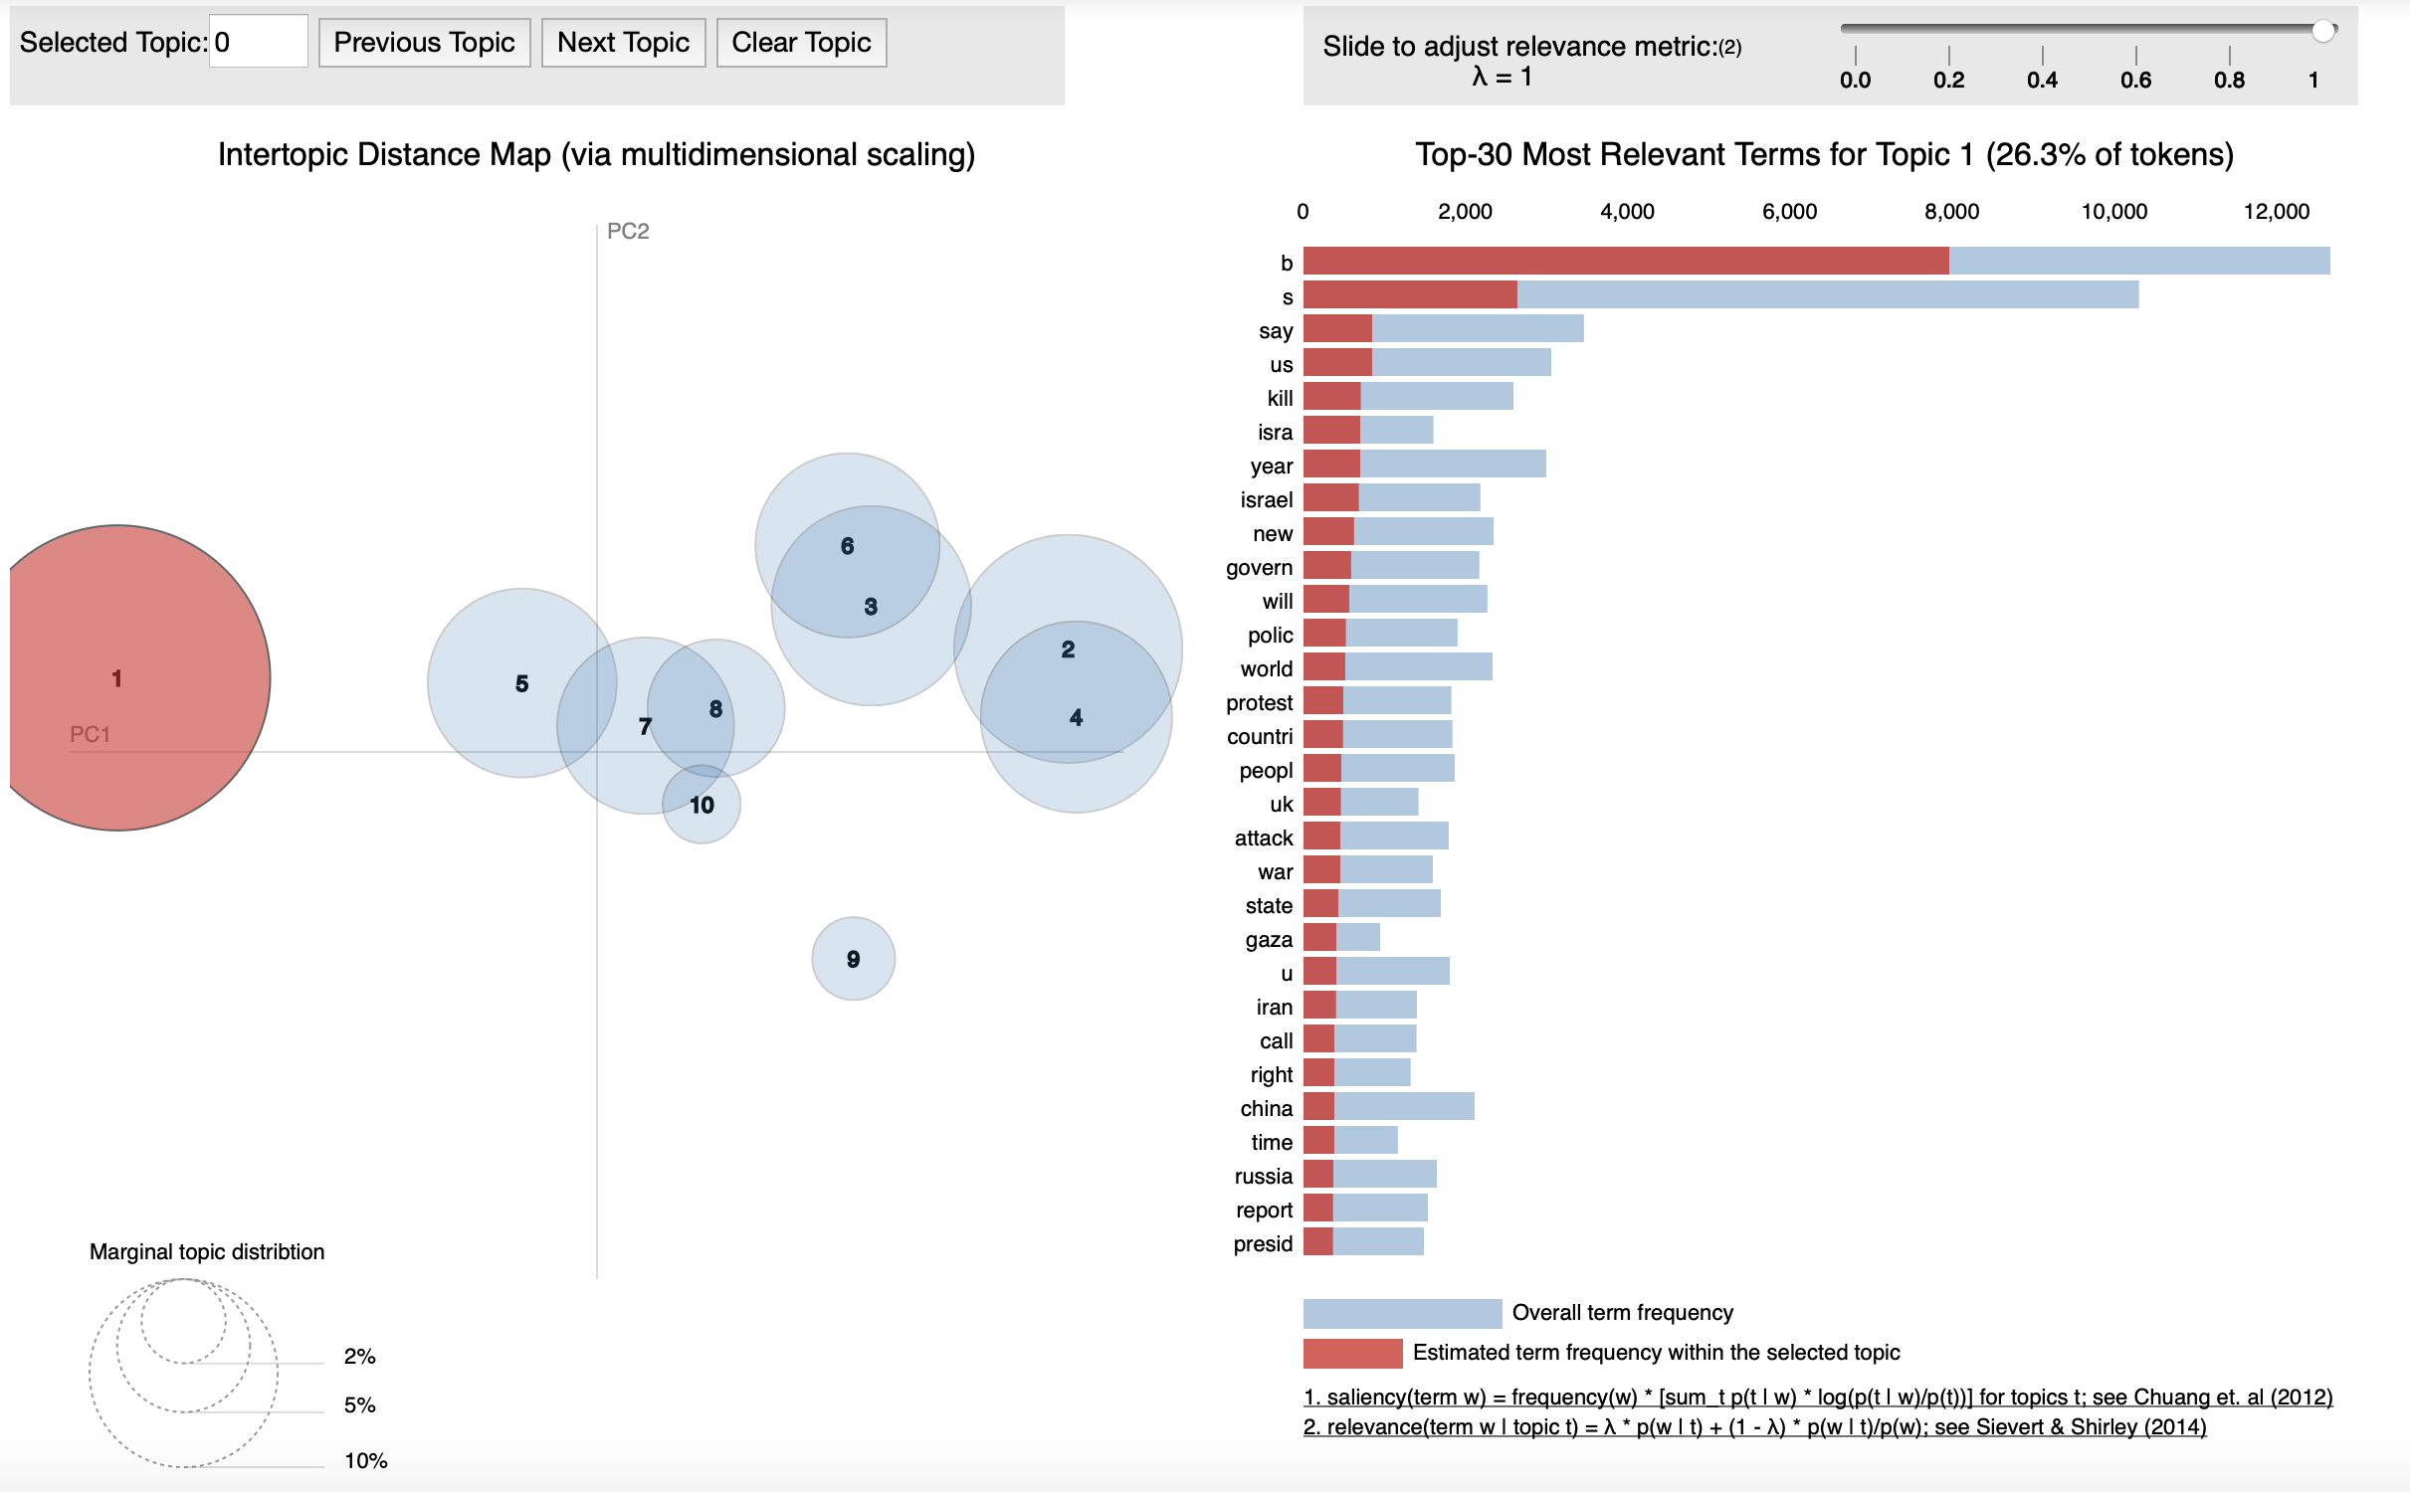
Data Exploration
LDA Analysis

Slide 8
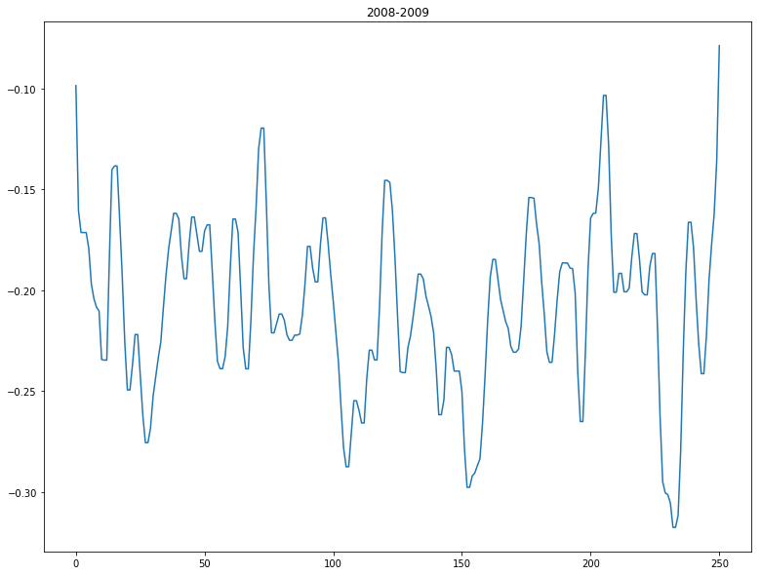
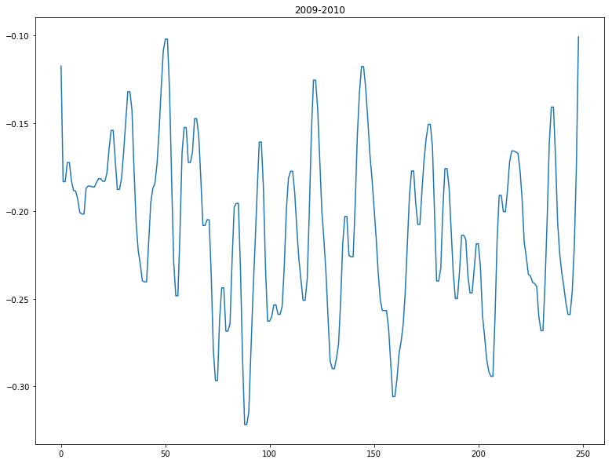
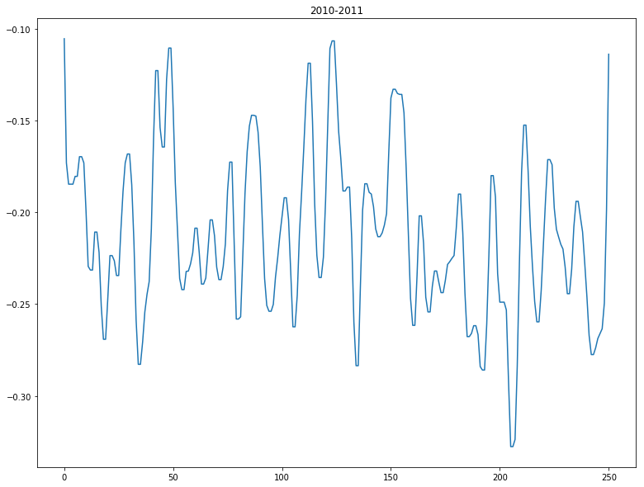
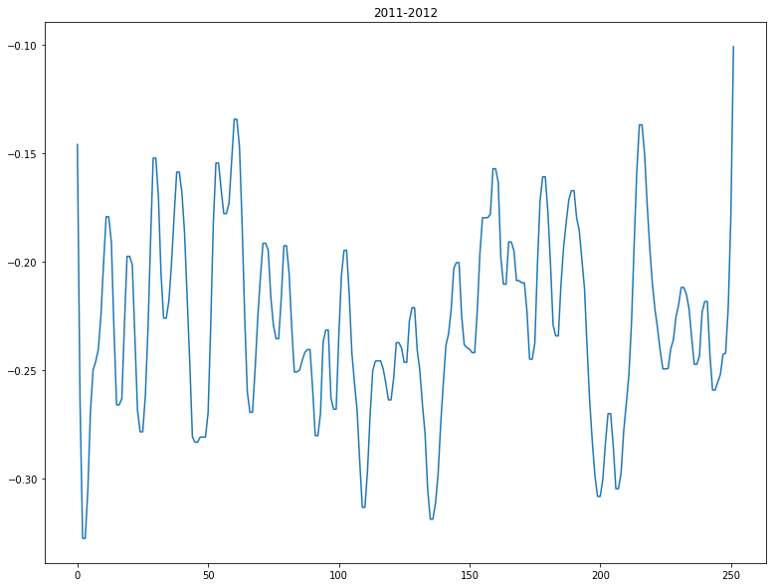
Sentiment Analysis

Slide 9
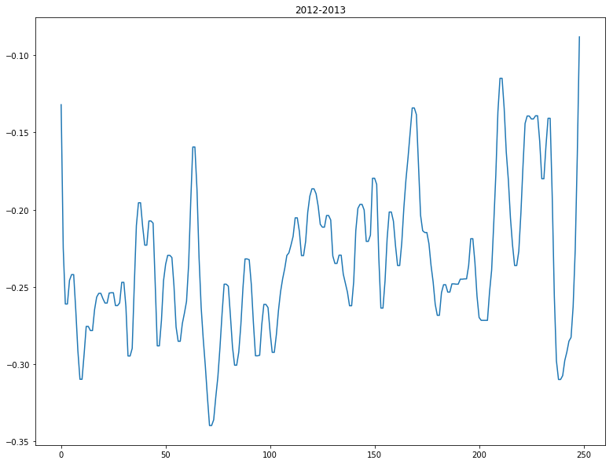
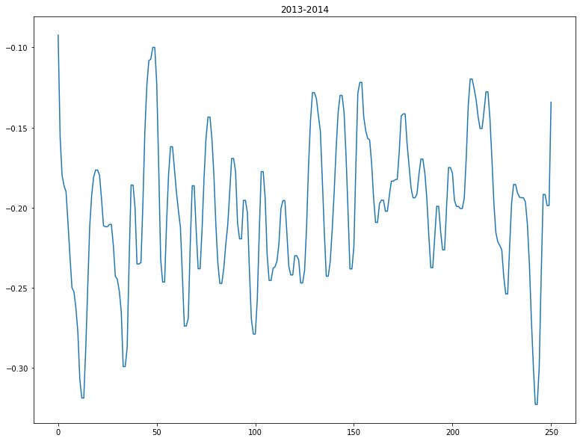
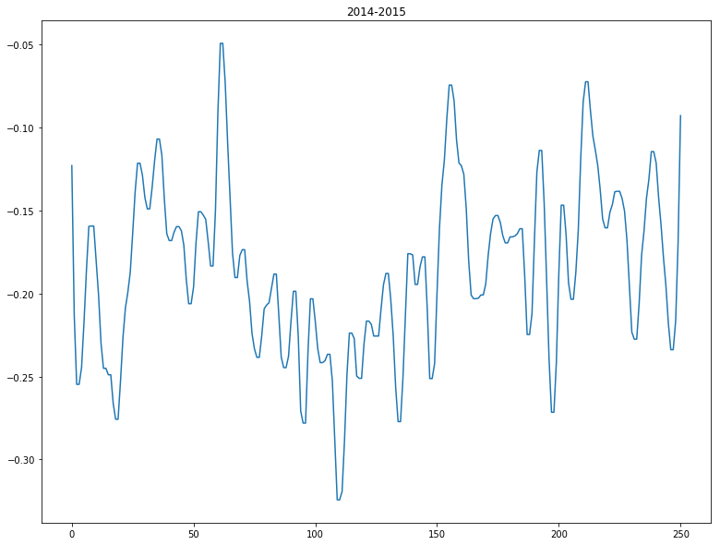
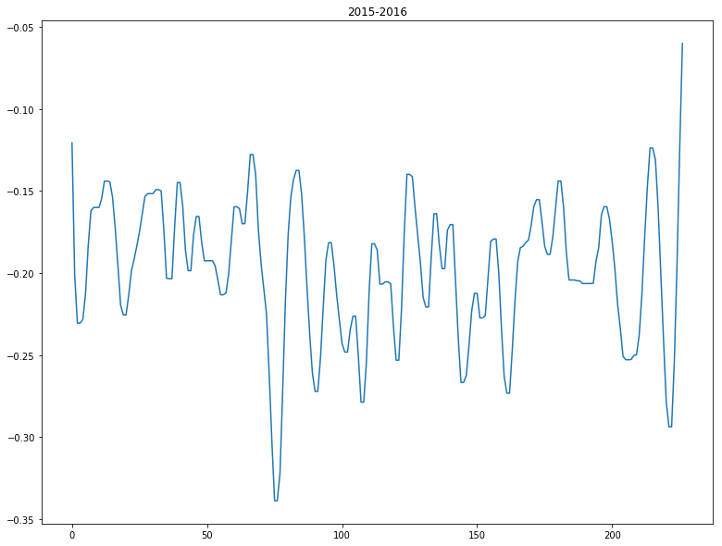
Sentiment Analysis
Notes:
转HTML

Slide 10
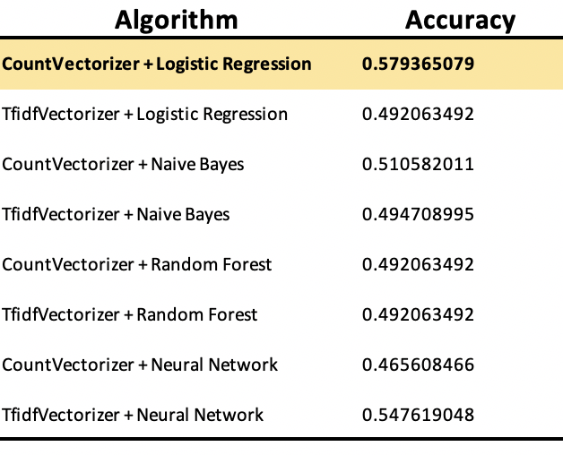
Stock-News Modeling
Machine Learning
Notes:
转render.html

Slide 11
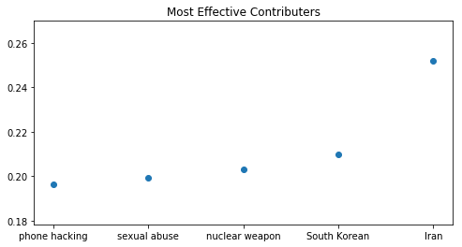
Stock-News Modeling
Most Effective Contributors

Slide 12
Characteristics of Market to watch
Ingrained counter reactions among market sectors
Lagging between news and market reactions
Negative news is better-selling
Investors are more risk-averse

